Slide 1

Predicting used car prices
By sivagami p

Slide 2
Problem Statement
Objective: Predict fair market price using ML
By analyzing historical used car data, the project aims to:
Identify the most influential factors affecting used car prices
Provide accurate and data-driven pricing recommendations
Assist buyers, sellers, and dealers in making informed pricing decisions

Slide 3
UNDERSTANDING DATASET
Rows: 1064 Columns: 19 Target Variable: Price
Features:
Company Kilometer CngKit City
Model BodyStyle Price Warranty
Variant TransmissionType Owner QualityScore
FuelType ManufactureDate DealerState
Colour ModelYear DealerName

Slide 4
Data preprocessing
Checked for missing values
filled missing values in “ Transmission type” with mode
filled missing values in “CngKit” with No
Changed target column ‘ Price’ to numeric
Encoded categorical variables
Dropped non informative columns( ID, DealerName, Model, Variant)

Slide 5
Feature engineering
Converted date column to datetime format
Created feature car age

Slide 6
Feature scaling
Features like Kilometer and QualityScore have different ranges
Standardized features to improve model performance

Slide 7
Exploratory data analysis
Distribution of used car prices
Comparing car age with price
Comparing fuel type with price
Transmission Type vs Price
Comparing quality score with price
Comparing owner with price
Feature correlation heatmap

Slide 8
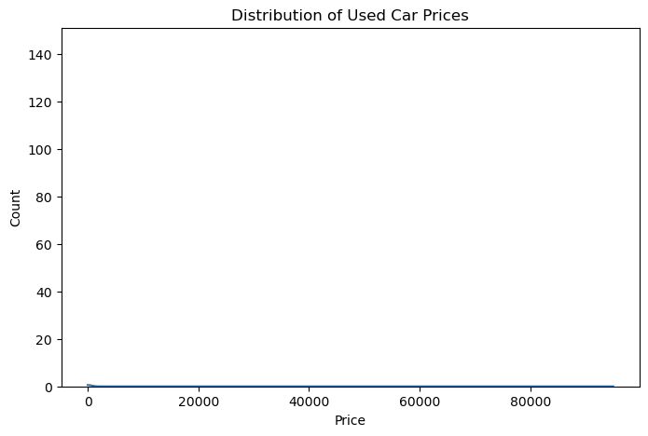
Distribution of used car prices
Used car prices are unevenly distributed with most vehicles concentrated in the mid-price segment.

Slide 9
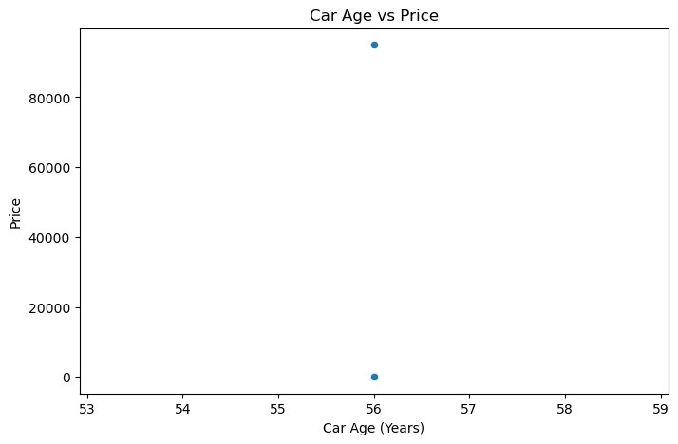
Comparing car age with price
Car age shows a strong inverse relationship with price.

Slide 10
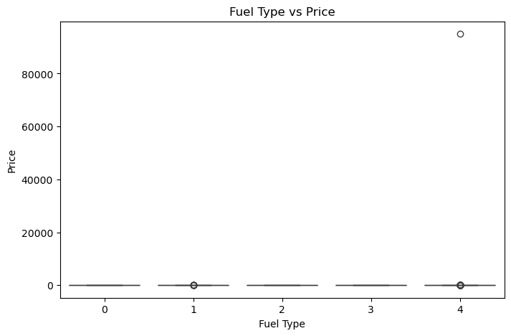
Comparing fuel type with price
Diesel and petrol vehicles show higher price ranges
Alternative fuels generally have lower prices
Fuel type influences resale value, with petrol and diesel cars priced higher

Slide 11
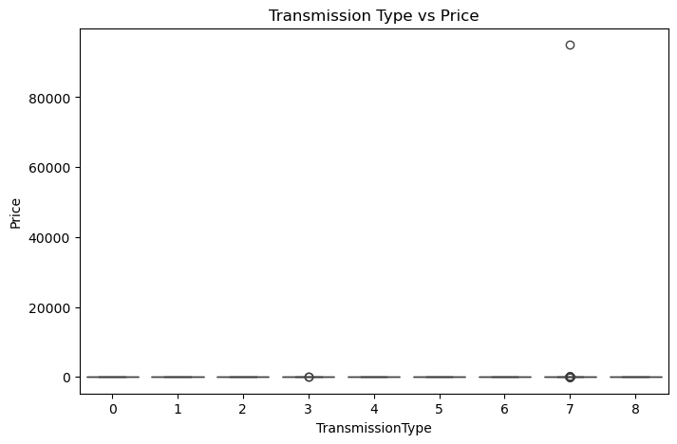
Transmission Type vs Price
Transmission type impacts pricing, with automatic cars generally costing more.

Slide 12
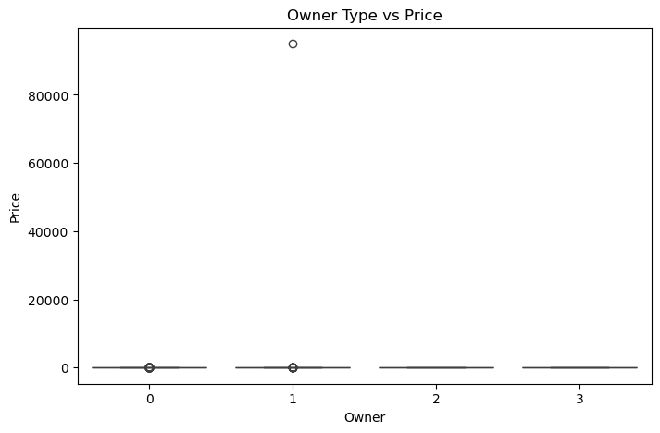
Comparing owner with price
First owner type correlates highly with high price

Slide 13
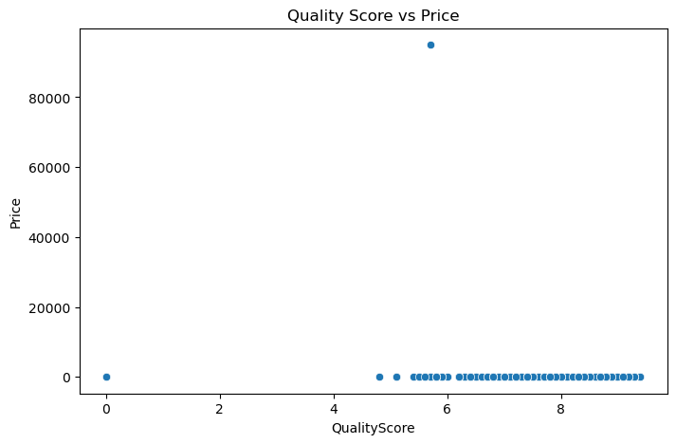
Comparing quality score with price

Slide 14
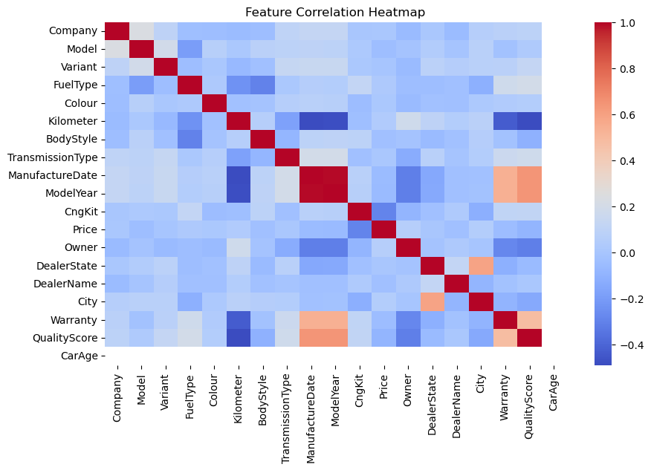
Feature correlation heatmap

Slide 15
Model building
Built the following models:
Linear regression
Decision tree
Random forest
Best model: Random forest

Slide 16
Random forest
Random Forest performs better than Decision Tree
Lower MAE & RMSE → better price prediction accuracy
Higher R² → explains more variance in price

Slide 17
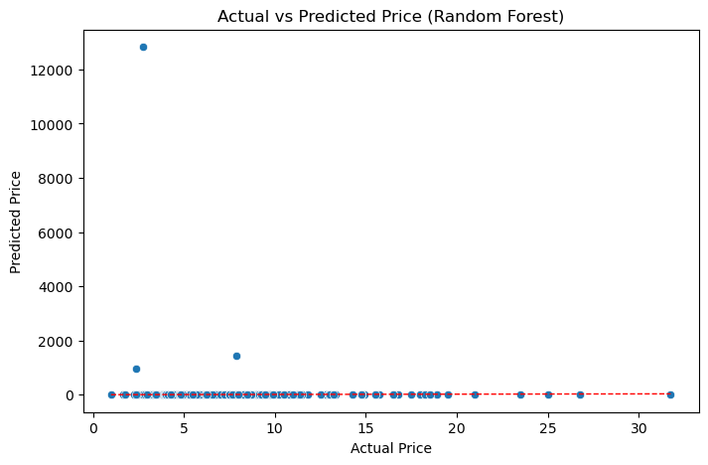
Comparing actual price with predicted price

Slide 18
Model Evaluation
Regression Models evaluated using MAE, RMSE, and R²
Classification model evaluated using Accuracy, Precision, Recall, and F1-score

Slide 19
Evaluation Metrics
Mean Absolute Error (MAE)
Mean Squared Error (MSE)
Root Mean Squared Error (RMSE)
R² Score

Slide 20
Model deployment
Model deployed using Streamlit web application

